Slide 1
Network and Communication
Module 6 Transport Layer Protocols
Dr. S.L.JAYALAKSHMI,
VIT Chennai

Slide 2
Session Outline
Transport Layer Protocols – An Introduction
Transmission Control Protocol (TCP)
User Datagram Protocol (UDP)
Difference between TCP and UDP

Slide 3
Transport Layer Protocols
Layer 4 protocol (in OSI model)
Provides Process-to-Process communication service
Also called as end-to-end prototcol
Performs Multiplexing and Demultiplexing
Transport Layer Protocols
Transmission Control Protocol (TCP)
User Datagram Protocol (UDP)
Runs over IP
TCP and UDP packets are encapsulated into IP packets
Use their own control information, stored in packet headers
Port numbers (indicate consuming program in the destination host)

Slide 4
Transmission Control Protocol (TCP)
Connection Oriented
Reliable Byte Stream service
Guaranteed in-order delivery
Full-duplex
Includes a flow-control mechanism
Implements congestion-control mechanism
Packets exchanges between TCP peers – Segments
Each Segment has a header

Slide 5
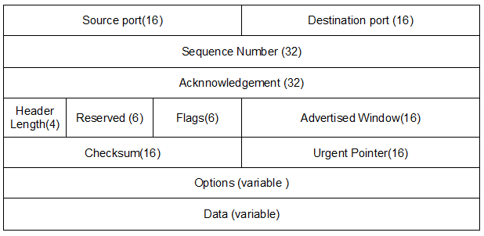
TCP Header Format
Both the TCP header and data must have a length in bits multiple of 32
{Source port, Source IP, Destination port, Destination IP} – uniquely identifies a TCP Connection
*Source - Computer Networking: A Top Down Approach Featuring the Internet, J.F.Kurose and K.W. Ross, Sixth Edition, Pearson Education, 2012

Slide 6
TCP Header
Flags:
SYN - establishing a TCP connection,
FIN - terminating a TCP connection
RST - close the connection
ACK – acknowledgment
PSH - push function
URG - signifies that this segment contains urgent data. If set, the urgent pointer field indicates the starting location of the nonurgent data

Slide 7
User Datagram Protocol (UDP)
Connectionless
Unreliable
Processes indirectly identify each other using port number (or mailbox)
UDP port field is only 16 bits long - there are up to 64K possible ports
Source process sends a message to a port and destination process receives the message from a port
Client know about the server’s port either through
Well known ports
Port mapper

Slide 8
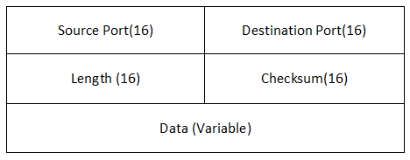
UDP Header
UDP packet: No state information for the communication session.
UDP is a stateless protocol, without re-transmission of loss data or protecting against data recording
*Source - Computer Networking: A Top Down Approach Featuring the Internet, J.F.Kurose and K.W. Ross, Sixth Edition, Pearson Education, 2012

Slide 9
Difference between TCP & UDP
TCP UDP
Connection Oriented Connectionless
Byte stream Service Datagram Service
Reliable Unreliable
Inorder delivery of data Unordered
Guaranteed delivery Best effort service (no guarantee)

Slide 10
Popular Internet applications and their underlying transport Protocols
*Source - Computer Networking: A Top Down Approach Featuring the Internet, J.F.Kurose and K.W. Ross, Sixth Edition, Pearson Education, 2012

Slide 11
References
Computer Networks: A Systems Approach, Larry L. P eterson and Bruce S. Davie, Fifth Edition, The Morgan Kaufmann Series, Elsevier, 2011.
Computer Networking: A Top Down Approach Featuring the Internet, J.F.Kurose and K.W. Ross, Sixth Edition, Pearson Education, 2012
Data Communication and Networking, Behrouz A. Fourozan, McGraw Hill Education, Fifth Edition, 2012

